Slide 1
The MUTCD and the Role of NCUTCD
INSERT NAME AND COMPANY
National Committee on Uniform Traffic Control Devices
INSERT DATE
Notes:
Change name & date as needed. Member of NCUTCD. Should take about 22-25 minutes to get thru.

Slide 2
Agenda
NCUTCD – History & Role
MUTCD Current Resources & Likely Content of the New MUTCD
FAQ’s
Official Interpretations
Interim Approvals
Official Experiments
The Next Edition of the MUTCD?
Notes:
Outline for presentation.

Slide 3
NCUTCD (www.ncutcd.org)
National Committee on Uniform Traffic Control Devices, formed 1980
Predecessor committees formed in 1931; wrote the 1935 - 1971 MUTCD editions
Since 1971, committees have advised FHWA on MUTCD – initiating recommended changes, reviewing proposals, submitting comments on rulemakings
Notes:
MUTCD belongs to FHWA, but NCUTCD is largest organization making recommendations to FHWA on manual.
More on NCUTCD-history, process.

Slide 4
NCUTCD
Focuses on standards and guidelines for traffic control devices
Recommends proposed revisions to the MUTCD to FHWA (organization responsible for the Manual)
Provides forum for professionals with diverse backgrounds to exchange information
Notes:
Lots of words, but showing there is an official definition of NCUTCD. Highlight purpose. Been around for over 35 years as NCUTCD (1979); over 85 years with previous organization (NAC).

Slide 5
NCUTCD Process
Consensus-building process over time
Utilize research/experimentation to improve existing devices or recommend new ones
Procedure
Technical Committee reviews completed research and/or experimentation
Draft proposal by technical committee
Review by sponsoring organizations
Revisions by technical committee
Discussed and voted on by Council
If approved, submitted to FHWA
Notes:
Our process/procedure.

Slide 6
NCUTCD Process for Changes
Notes:
Snapshot of flow chart for impact of thoroughness. Audience may have trouble reading it; showing it is more for emphasis.

Slide 7
NCUTCD Structure
Governing By-laws
Sponsoring Organizations (21)
Council (votes on proposals) 41 voting members representing 21 sponsoring organizations
Executive Board
8 Technical Committees
300+ Professional Volunteer Members from cities, states, counties, academia, industry, user groups - open to those engaged in practices related to TCD’s and roadway safety
Notes:
Additional items to show formal organization and how large it is. Per by-laws, individuals or sponsoring organizations may submit requests to NCUTCD for changes to the Manual.

Slide 8
NCUTCD Organization
Notes:
Simple graphical view of Committee. Detailed version on next slide to use depending on audience. EDIT Committee: appointed group lead by Vice–Chair of Programs; responsible for reviewing proposed wording to the MUTCD by the Technical Committees to assure that wording is consistent in formatting and style; Edit Committee is also responsible for making recommendations regarding Part 1.

Slide 9
NCUTCD Organization
Group I: Agencies
(25 members)
8 AASHTO
8 ITE
3 APWA
3 NACE
3 NACTO
Council
(41 members)
Sponsoring Organizations
Executive
Board
Secretary
Edit
Group II: National Organizations
(9 members)
1 APTA
1 AREMA
1 AAR
1 APBP
1 ASCE
1 IACP
1 IBTTA
1 IMSA
1 ITSA
Research
Technical Committees
Regulatory and Warning Signs
Guide and Motorist Information Signs
Technical Committees
(8 committees)
Markings
Group III: Public
(4 members)
1 AAA
1 HFR
1 LAB
1 NSC
Signals
Task Forces
Temporary Traffic Control
Railroad and Light Rail Transit Highway Grade Crossings
Group IV: Industry
(3 members)
1 AHUA
1 ARTBA
1 ATSSA
Bicycle
Notes:
Thorough outline of how NCUTCD is organized and interconnectedness. Use the simple version, the detailed version or both, depending on the audience.

Slide 10
NCUTCD (sponsoring organizations)
American Assoc. of State Highway & Transportation Officials (AASHTO)
American Automobile Association (AAA)
American Public Transportation Association (APTA)
American Public Works Association (APWA)
American Railway Engineering & Maintenance of Way Association (AREMA)
American Road & Transportation Builders Association (ARTBA)
American Society of Civil Engineers (ASCE)
American Traffic Safety Services Association (ATSSA)
Association of American Railroads (AAR)
Association of Pedestrian and Bicycle Professionals (APBP)
American Highway Users Alliance (AHUA)
Human Factors Resources (HFR)
Institute of Transportation Engineers (ITE)
Intelligent Transportation Society of America (ITSA)
International Assoc. of Chiefs of Police (IACP)
International Bridge, Tunnel & Turnpike Association (IBTTA)
International Municipal Signal Association (IMSA)
League of American Bicyclists (LAB)
National Association of City Transportation Officials (NACTO)
National Association of County Engineers (NACE)
National Safety Council (NSC)
Notes:
List of names and abbreviations shown on org chart.

Slide 11
USDOT MUTCD Team
Notes:
Org chart of USDOT and how FHWA MUTCD Team fits, including the MUTCD Chapters for which each is responsible.

Slide 12
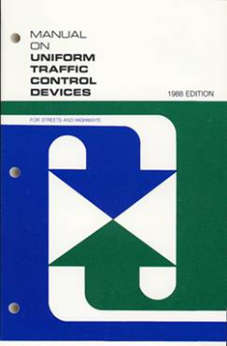
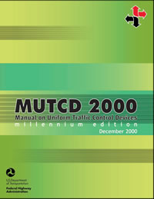
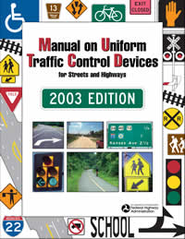
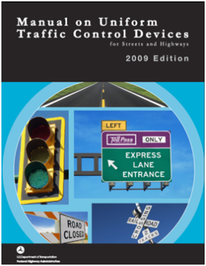
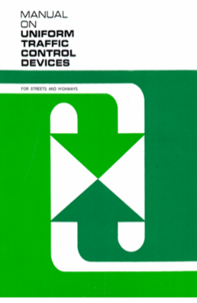
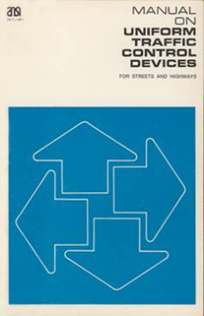
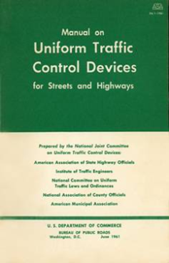
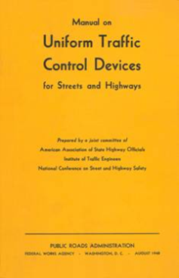
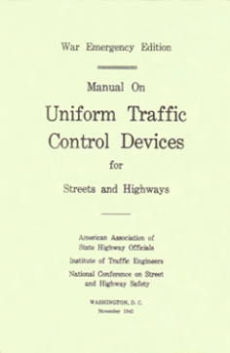
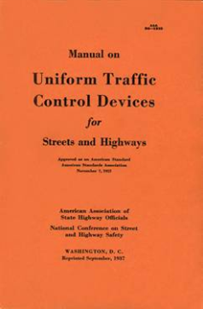
Evolution of the MUTCD
Over 80 years & 10 Editions
Working Toward 20?? MUTCD
1935
Future
Notes:
MUTCD is in 10th edition covering over 80 years. Since the last edition in 2009, NCUTCD has been working hard on developing improvements for the next edition of the MUTCD.

Slide 13
MUTCD (https://mutcd.fhwa.dot.gov/)
Notes:
Shows MUTCD website and all the information available on it; including current revision of Manual and available resources.
Importance of this slide is also to set the stage of regulatory process and why it takes so long to get thru process, which now takes longer (highlighted in later slide).

Slide 14
Frequently Asked Questions (FAQ’s)
The FHWA's MUTCD Team receives questions daily about a wide variety of issues involving traffic control devices and the MUTCD
As a resource to practitioners, some of the most frequently-asked questions, along with the answers to those questions, are posted on the FAQs web page of the MUTCD web site
All of the FAQs are relevant to the 2009 MUTCD
Notes:
Transition into available Resources: First is Frequently Asked Questions.

Slide 15
Official Interpretations
Purpose is to allow the FHWA to provide additional clarity to practitioners when a provision in the MUTCD is difficult to understand or when situations arise where complying with a particular provision would be challenging or impractical
An Official Interpretation is not a revision to the MUTCD and should be considered as FHWA policy guidance or FHWA's recommendation of appropriate or best practice
Notes:
Next resource: Official Interpretations.

Slide 16
Official Interpretations
A total of 86 official interpretations have been issued since the 2009 MUTCD was published, with the following distribution by parts:
Part 1. General – 2
Part 2. Signs – 18
Part 3. Markings – 5
Part 4. Highway Traffic Signals – 29
Part 5. Low-Volume Roads – 1
Part 6. Temporary Traffic Control – 16
Part 7. School Areas – 1
Part 8. Grade Crossings – 7
Part 9. Bicycle Facilities – 7
Notes:
Exhibit to give idea of number of Official Interpretations available to help understand the Manual.

Slide 17
Interim Approvals
Purpose is to allow the interim use, pending official rulemaking, of a proven successful new traffic control device, a revision to the application or manner of use of an existing traffic control device, or a provision not specifically described in this Manual
It is issued by official memorandum and includes technical conditions for use (design, placement, etc.)
Notes:
Next resource: Interim Approvals.

Slide 18
Interim Approvals
Criteria for a new device to be considered for FHWA issuance of an Interim Approval:
Successful experimentation and/or research in diverse geographic regions or conditions (not just a single jurisdiction)
Assessment of relative risks, benefits, costs, impacts, and other factors
FHWA intention to propose the device for the next edition of MUTCD and a high likelihood of its adoption in the Final Rule

Slide 19
Interim Approvals - Requirements
Standard: A jurisdiction, toll facility operator, or owner of a private road open to public travel that desires to use a traffic control device for which FHWA has issued an interim approval shall request permission from FHWA.
Guidance: The request for permission to place a traffic control device under an interim approval should contain the following:
A. A description of where the device will be used, such as a list of specific locations or highway segments or types of situations, or a statement of the intent to use the device jurisdiction-wide;
B. An agreement to abide by the specific conditions for use of the device as contained in the FHWA’s interim approval document;
C. An agreement to maintain and continually update a list of locations where the device has been installed; and
Notes:
I use the standard and guidance wording from the Manual for impact. This slide gives requirements (even though some guidance).

Slide 20
Interim Approvals - Requirements
D. An agreement to:
1. Restore the site(s) of the interim approval to a condition that complies with the provisions in this Manual within 3 months following the issuance of a final rule on this traffic control device; and
2. Terminate use of the device or application installed under the interim approval at any time that it determines significant safety concerns are directly or indirectly attributable to the device or application. The FHWA’s Office of Transportation Operations has the right to terminate the interim approval at any time if there is an indication of safety concerns.
Notes:
While still guidance, these are major RISKS. Potential legal implications.

Slide 21
Interim Approvals
A total of 22 Interim Approvals since 2003; 11 have been issued since the 2009 MUTCD was published:
Alternative Traffic Signal Photo Enforced sign-Nov 2010
Alternative Electric Vehicle Charging sign - April 2011
Green Colored Pavement for Bike Lanes - April 2011
Alternative U.S. Bicycle Route sign - June 2012
Bicycle Signal Faces - Dec 2013
Optional Use of 3-Section FYA Signal Faces- Aug 2014
Optional use of an Intersection Bicycle Box – Oct 2016
Alt. Signal Warrant 7 – Crash Experience – Feb 2017
Optional Use-Two-Stage Bicycle Turn Box – June 2017
Rectangular Rapid Flashing Beacon – March 2018
Op Use of Red-Colored Pavem’t for Transit – Dec 2019
Notes:
Highlight IA’s.

Slide 22
Interim Approvals
Two interim approvals issued prior to the 2009 MUTCD were in effect until recently, but re-instated:
Notes:
Usually give brief overview. For RRFB’s, explain that the originator of the idea has gone back and gotten a patent on the RRFB and is suing manufacturers. FHWA was caught totally off guard. Therefore, they suspended any New approvals for use. However, after reviewing all available means to find a solution, they had to terminate the use of the RRFB. IA’s are not to be patented or controversial.

Slide 23
Clearview Font
Issued in September 2, 2004
Rescinded in January 25, 2016
Reinstated March 28, 2018
Notes:
Highlight IA’s.

Slide 24
Rectangular Rapid Flashing Beacons
Issued in July 16, 2008 (IA-11)
Suspended 2016
Rescinded December 17, 2017
Reinstated March 20, 2018 (new IA-21), with revisions
Notes:
Highlight IA’s.

Slide 25
Interim Approvals
Following are the number of agencies (as of 12/4/19) that have requested and received the FHWA’s permission to use these interim approved devices:
Alternative Traffic Signal Photo Enforced sign – 8
Alternative Electric Vehicle Charging sign – 13
Green colored pavement for bike lanes – 135
Alternative U.S. Bicycle Route sign – 13
Bicycle Signal Faces – 55
Three Section FYA – 22
Intersection Bicycle Box – 57
Alt Signal Warrant #7 – Crash Experience – 14
Two Stage Bicycle Turn Box – 35
Rectangular Rapid Flash Beacon – 105
Notes:
Again, exhibit to give magnitude of the important resource. Also show magnitude of potential problem with RRFB’s if rescinded.

Slide 26
Official Experiments/Rulings
Goal- to seek the best traffic control devices
Purpose – to allow practitioners to test new or innovative traffic control devices or applications:
To see if they perform more effectively than the devices in the MUTCD; or
Because there is no device in the MUTCD that addresses the situation being studied
Notes:
Transition into next resource: Experimentation. The information on experiments is found under the Official Rulings on the FHWA website.

Slide 27
Official Experiments
A State DOT or a local agency must write a letter to the FHWA requesting to conduct an experiment
Request must include a research plan describing what data will be collected, how it will be collected, and how it will be analyzed
Key is for experimental plan to produce data for objective (not subjective) results with quantifiable performance measures
Experiment may begin only after written approval from the FHWA
Successful experimentation is utilized by NCUTCD & FHWA to recommend updates to the Manual
Notes:
Wordy, but important facts to making experimentation work.

Slide 28
Official Experiments
There have been 163 official active experiments since the 2009 MUTCD was published, with the following distribution by parts:
Part 1. General – 0
Part 2. Signs – 13
Part 3. Markings – 25
Part 4. Highway Traffic Signals – 28
Part 5. Low-Volume Roads – 0
Part 6. Temporary Traffic Control – 18
Part 7. School Areas – 0
Part 8. Grade Crossings – 4
Part 9. Bicycle Facilities – 75
Notes:
Summary of Experiments and significance of this element of the process.

Slide 29
Why are Official Experiments Important?
A jurisdiction that installs a device or application that is not in the MUTCD, that violates MUTCD requirements, or that has not received Interim Approval status, without first obtaining FHWA experimentation approval, faces these risks:
Potential legal liability if a crash occurs
Potential loss of Federal-Aid funding
Notes:
Very important slide (from FHWA slide in another presentation). Give emphasis.

Slide 30
Estimated Time Line for 20?? Edition
Based on MUTCD Rulemaking being treated as a Significant Regulatory Action: [Speculative – to explain timeframe; assumes things go relatively smoothly]
At each meeting, NCUTCD meets for generating recommendations and sends to FHWA for the next NPA
6 months - FHWA Completes final draft of NPA to update MUTCD, including economic analysis of proposed changes
5 months - Internal, OMB and OST Reviews
2 months - Publish NPA in Federal Register
6 months - docket comment period
12 months - Finalize the MUTCD & Federal Register notice
4 months - Internal, OMB and OST Reviews
5 months - Publish the Final Rule for a new edition of the MUTCD
40 months + 24 months for state adoption
Notes:
Based on input from the Office of Management and Budget, we have been directed to treat this proposed Rulemaking as a Significant Regulatory Action. Accordingly, an economic analysis of the proposed changes has to be done, and additional time has to be built in to accommodate the enhanced review associated with significant actions. The schedule is dictated by the Federal Gov’t. Use this slide or the next one with a graphical view of the process.

Slide 31
Estimated Time Line for “Next” Edition
“Smooth” Time Line
Up to 64 months
Notes:
This slide offers a graphical view of the federal process. Use this slide or the previous word version.

Slide 32
Next Steps for NCUTCD
Continue reviewing research/experimentation and recommending MUTCD revisions/improvements
Identify and eliminate redundant or unnecessary text
Reorganize content where opportunities for improving flow are identified
Reassess each standard and retain, delete or downgrade
Assist FHWA by reviewing and commenting on requests for interpretation and new devices
Urge FHWA to continue use of Interim Approvals
Notes:
Transition into where we go from here.

Slide 33
Next Steps for NCUTCD
Ideas from 2013 Request for Comment (smart search apps; cross indexing; fact sheets; new figures or tables; expanded hot links, etc.)
Recommendations from NCUTCD strategic plan and vision
- Focus on ideas for enhancing future editions
- Encourage FHWA to take actions based on RFC and comments received
Request research and monitor results for changes to the Manual
Notes:
In addition to the enhancements developed to the 2009 edition already mentioned, we will continue to explore other ideas to make the Manual better.

Slide 34
20?? MUTCD
A new edition of the MUTCD, with new devices and applications, is coming, but …
Unsure when! No indication it will move forward under the new administration, until ????
Meanwhile, keep an eye out for additional Interim Approvals, Official Interpretations and perhaps small revisions to the 2009 edition (http://mutcd.fhwa.dot.gov)
Notes:
What about a new Manual? Reminder to continue to look at the FHWA website for information.

Slide 35
Thank you!
INSERT NAME?
INSERT TITLE?
INSERT COMPANY NAME?
INSERT PHONE NUMBER?
INSERT EMAIL ADDRESS
Acknowledgements to ITE Professional Development & FHWA for some of content.
Notes:
Change name and contact information as needed.
Take time to give thanks to ITE and FHWA for allowing use of some of their presentation material.

Slide 36
Thank you!
If interested in getting involved or becoming a member, visit: (www.ncutcd.org)
Questions?
Notes:
Open for questions. Give a plug for NCUTCD.

